Slide 1


Slide 2








Contents
Active Reading 1

Slide 3


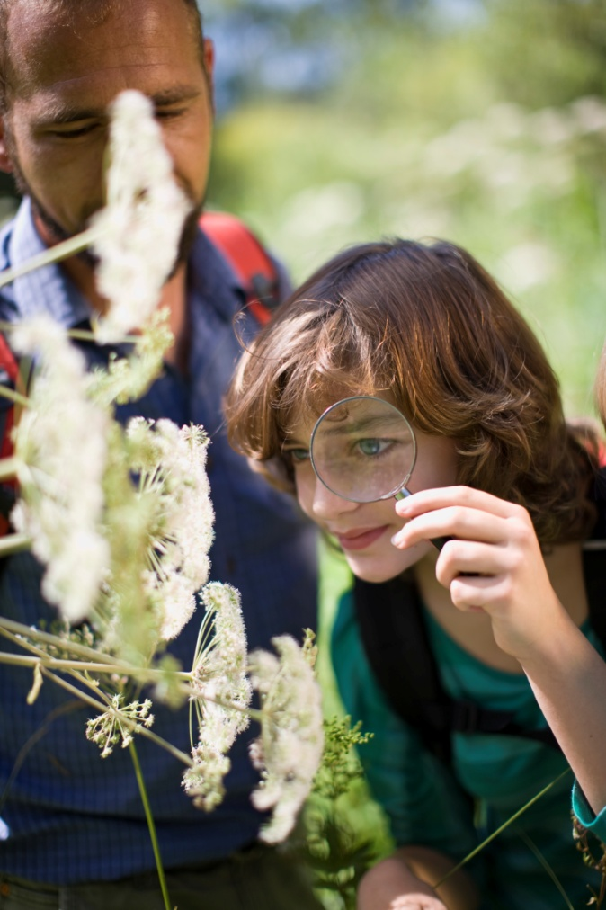
Warming Up
Watch a video clip
Read some statements
Group discussion

Slide 4



Warming Up
Watch a video clip and answer the following questions.
What do you think of the teachers in the movie, especially Mr Keating, the one who teaches poetry? Do you like him? Why or why not?

Slide 5
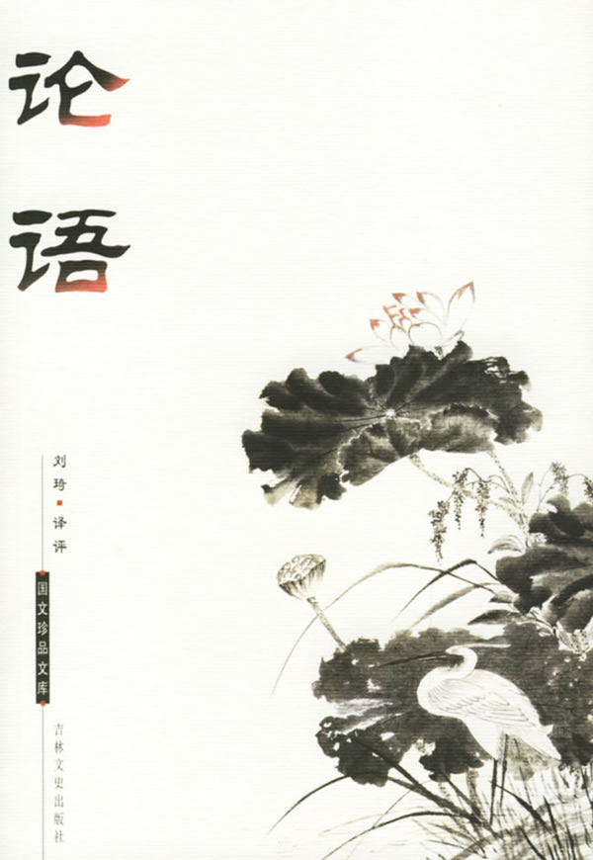

Warming Up
Read the following statements.
Statement 1
If one learns from others but does not think, one will be bewildered. If, on the other hand, one thinks but does not learn from others, one will be imperilled.
—Confucius
学而不思则罔，思而不学则殆。
The Analects

Slide 6
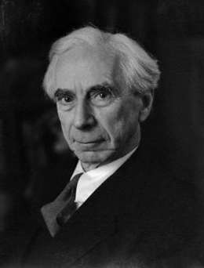
Warming Up
Statement 2
Passive acceptance of the teacher’s wisdom is easy to most boys and girls. It involves no effort of independent thought, and seems rational because the teacher knows more than his pupils; it is moreover the way to win the favour of the teacher unless he is a very exceptional man. Yet the habit of passive acceptance is a disastrous one in later life.
Bertrand Russell,
a British philosopher
—Bertrand Russell

Slide 7
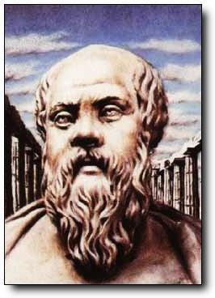
Warming Up
Statement 3
Education is the kindling of a flame, not the filling of a vessel.
—Socrates
Socrates

Slide 8
Warming Up
Group discussion
1. What is the relationship between learning and thinking?
2. What is your understanding of “thinking for yourself”?
3. Is it important to think for yourself? Why or why not?
4. Have you ever been encouraged to think for yourself? And how?

Slide 9


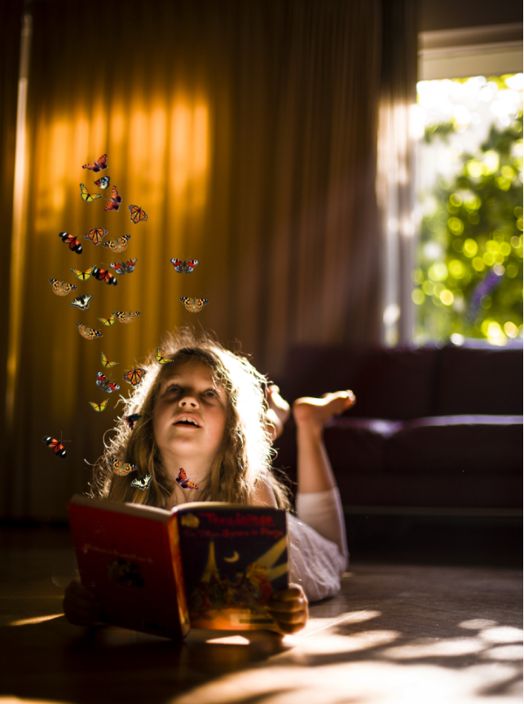
Text
Thinking for yourself

Slide 10

Text
Thinking for yourself
1 Thinking for yourself is still a radical act. 2 Thinking for yourself is not a popular activity, though it should be. Every step of real progress in our society has come from it. But in most circles, particularly in places that shape our lives – families, schools and most workplaces – thinking for yourself is regarded with suspicion. Some institutions thwart it on purpose. It can be seen as dangerous.

Slide 11
Text
3 I was reminded of this sad fact at a party when a fellow guest asked me the subject of a book I was planning to write. I told him that it was about how people can help each other to think for themselves. “Oh dear,” he said, “I don’t think much of that; I much prefer people do as they’re told.” I later found out that he is the fourth- generation president of one of the largest oil companies.

Slide 12
Text
4 When was the last organizational vision statement you saw that included the words “… to develop ourselves into a model environment in which everyone at every level can think for themselves”? For that matter, when was the last time somebody asked you, “What do you really think, really?” and then waited for you to answer at length?

Slide 13
Text
5 This dearth should not surprise us. Hardly anyone has been encouraged, much less trained, to think for themselves, and their teachers and parents and bosses weren’t either. And neither were theirs. (We may have learned to revere thinkers like Socrates, but we also learned that the state poisoned him for thinking for himself: not unmitigated encouragement.)

Slide 14
Text
6 Occasionally, however, we do have a teacher or mentor who truly wants us to develop our own thinking. They give us glimpses. When I was 13 years old, I was put into an advanced algebra course. On the first day the teacher, who was maligned by students as a hard teacher because she tried to get them to think, stood in front of the blackboard and said, “On the paper in front of you write the sum of a number.”
7 The entire class of 35 pubescent people just stared at her. She repeated the direction, “Write the sum of a number.”

Slide 15
Text
8 I remember my hand gathering sweat around the pencil. A few heads looked down and their pencils started up. I wondered what in the world they were writing. I saw the girl across the aisle from me lean forward and peer over the shoulder of the boy in front of her who was scribbling something. Then she scratched a figure and immediately covered it with her hand.
9 The teacher paced and rubbed the chalk between her fingers. I wondered what she was about to put on the board. I was now the only one not writing. I leaned back and over my left shoulder whispered to my friend, “What is it?”

Slide 16
Text
10 “Seven,” she whispered back.
11 So I wrote “7” on my paper. I kept my head down, hoping I looked busy and confident. 12 After the agony among us had become tactile, the teacher asked us for our answers. The number 7 was prevalent. She walked slowly over to the board and wrote: “There is no such thing as the sum of a number”.

Slide 17
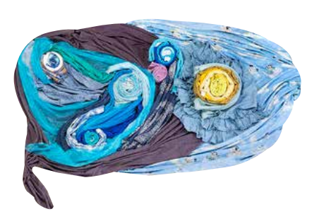
Text
13 I knew that. 14 Why didn’t you write it? 15 Sarah said it was 7. 16 Why did you ask her? 17 Because – I don’t know. 18 That’s right. From now on, think for yourself.

Slide 18
Text
19 I was too scared around that teacher for the rest of my young life to think very well in her presence. But I took the message with me and gradually examined and valued it. I don’t recommend humiliating people into thinking for themselves as she had. She certainly did not create a Thinking Environment for us. Had she affirmed our intelligence first and spoken about the joy of thinking for ourselves, had she not fanned our fear of her, we would all have learned even more powerfully what it meant to do our own thinking. And we might have been able to think well around her too. 20 But at least she introduced the concept into my academic life.
■

Slide 19

Text
独立思考
1 直到现在，独立思考仍然是一种激进的行为。
2 独立思考本该是一种普遍的行为，而事实却并非如此。我们社会的每一次重大进步都源于独立思考。然而，在大多数的生活圈子里，尤其是那些影响我们一生的地方——家庭、学校以及大部分工作场所——人们都对独立思考持怀疑态度。有些机构甚至故意压制独立思考。独立思考被视为是一件危险的事情。

Slide 20
Text
3 在一次聚会上，当一位客人问起我酝酿中的一本书的主题时，我再次想起了这个令人悲哀的事实。我告诉他那本书谈论的话题是大家可以互相帮助，培养独立思考的能力。“天哪，”他说，“我不认为那有什么好，我更喜欢服从命令的人。”后来，我得知他是一家大公司的第四代掌门人，而那家公司是世界上最大的石油公司之一。

Slide 21
Text
4 “在我们周围逐渐创建出一个模型环境，使各个层次的人都有独立思考的空间。”你最后一次看到包含上述字眼儿的机构愿景陈述是在什么时候？还有，上一次有人问你：“你能跟我说真心话吗，真心话？”然后等着你做出翔实、充分的回答是在什么时候？

Slide 22
Text
5 缺乏独立思考并不奇怪。很少有人被鼓励去进行独立思考，更谈不上接受相关的训练。他们的老师、父母和老板也是如此。而且老师、父母和老板的老师、父母和老板也是如此。（我们可能早就知道应该尊敬像苏格拉底那样的思想家，可是我们也知道，因为独立思考，他所在的城邦毒死了他。这可绝不是给予他的毫无保留的鼓励）。

Slide 23
Text
6 可是，我们偶尔也会遇到真心想培养我们独立思考的老师或导师。他们让我们对独立思考的重要性有了浅略的认识。13岁时，我上了一门高级代数课。授课的老师由于要求学生思考而背上了难缠的恶名。第一天上课时，老师站在黑板前面说：“在你们面前的纸上写出一个数字的和。”
7 全班35个少男少女全都瞪大了眼睛看着她。她重复了一遍指令：“写出一个数字的和。”

Slide 24
Text
8 我记得我握着铅笔的手出汗了。有些人低下了头，握着手中的铅笔开始写了起来。我真不知道他们到底在写什么。我看见过道对面跟我坐同一排的那个女生向前探出身子，看看前面那个正胡乱写字的男生都写了些什么。然后她飞快地写下了一个数字，并且马上用手盖住了。
9 老师来回踱着步，手里碾着粉笔。我不知道她将在黑板上写什么。这会儿，就剩下我一个人还什么都没写。我往后一靠，向左侧过脸，悄悄地问我的朋友：“答案是什么？”

Slide 25
Text
10 “7，”她悄声说。
11 于是，我在纸上写下了“7”。我一直低着头，想让自己看上去既忙着做题，又信心百倍。
12 在明显地感觉到我们的苦恼之后，老师问我们答案是什么。大部分人都说是“7”。她慢慢地走到黑板前写道：“根本就不存在一个数字的和。”

Slide 26
Text
13 我知道是这样的。
14 那你为什么不这么写呢？
15 萨拉说是“7”。
16 你为什么要问她？
17 因为——我不知道。
18 这就对了，从现在开始，要独立思考。

Slide 27
Text
19 在后来的青葱岁月里，我一见到这位老师就害怕。在她面前，我根本就无法好好地思考。但是，我记住了她的教诲，并且渐渐地开始审视它、珍视它。我并不是劝大家像她那样，用羞辱别人的办法去教他们独立思考。她当然没有给我们创造一个思考的环境。要是她一开始就肯定我们的聪明才智，给我们讲讲独立思考的乐趣，要是她没有激起我们对她的畏惧，我们大家就能更深切地体会到独立思考的意义。而且，我们在她面前也会更好地开动脑筋、思考问题。
20 但至少，她把独立思考的概念引入了我的学术生活。

Slide 28

Words & Phrases
radical
occasionally
rub
particularly
mentor
agony
workplace
glimpse
tactile
suspicion
advanced
prevalent
thwart
algebra
presence
organizational
malign
humiliate
vision
sum
affirm
dearth
pubescent
powerfully
revere
aisle
unmitigated
lean

Slide 29
Words & Phrases
think for yourself
at (great / some) length
on purpose
start up
not think much of
be about to do
find out
at least
for that matter
Socrates 苏格拉底

Slide 30

Words & Phrases
radical a. (of opinions etc.) based on the belief that important political or social changes are necessary 激进的；极端的
e.g.
He also had radical views on politics.
他对政治也有极端的看法。
Opening borders to let many more job-seekers go where they please would be radical, but it would not mean allowing criminals, drug-smugglers or terrorists to move freely between countries.
开放边界让更多的求职者去梦想之地是激进的，但它并不意
味着允许罪犯、毒品贩子或恐怖分子在国与国之间自由地穿
梭。

Slide 31
Words & Phrases
particularly ad.
1. used for emphasizing that sth. refers especially to one specific person, thing, or situation 尤其
e.g.
When all the people of the world remember to laugh, particularly at themselves, there will be no more dictators and no more wars.
当世界上所有的人都记得大笑，尤其是笑他们自己，就不会
有独裁者，也不会有战争了。
His remarks were particularly helpful.
他的话特别有帮助。
2. very or very much 非常；特别
e.g. Progress has been particularly disappointing.
进展情况令人非常失望。

Slide 32
Words & Phrases
workplace n. [C] the place where you work 工作地点；工作场所
e.g.
Their houses were workplaces as well as dwellings.
他们的房子不仅是住所，还是工作场地。
Workplace canteens are offering healthier foods than ever before.
单位餐厅以前从没供应过像现在这样健康的饭菜。

Slide 33
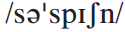
Words & Phrases
suspicion n.
1. [U] a feeling that you do not trust sb. or sth. 不信任；猜疑
e.g.
1. Suspicion is the poison of friendship.
猜疑是友谊的毒药。
2. She always treated us with suspicion.
她对我们总是不信任。
2. [C] a feeling that sb. has done sth. wrong（对某人做错事的）怀疑，猜疑，疑心
e.g. Neighbours’ suspicions were aroused by the bruises
on the child’s arms.
孩子手臂上的伤痕引起了邻居们的怀疑。
Word family: suspect v. 怀疑 n. 嫌疑犯
suspicious a. 可疑的

Slide 34
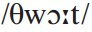
Words & Phrases
thwart vt. (fml) to prevent sb. from doing sth. they want to do 阻挠；作梗；使…受挫
e.g.
We successfully thwarted the enemy’s conspiracy.
我们成功地挫败了敌人的阴谋。
The accounting firm deliberately destroyed documents to thwart government investigators.
会计事务所故意毁坏文件，阻挠政府调查。

Slide 35
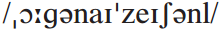
Words & Phrases
organizational a. relating to the structure of an organization 组织的；结构的
e.g.
The police now recognize that big organizational changes are needed.
警方现在意识到需要进行大幅度的机构调整。
There was no strong organizational base on which to build.
建设缺乏一个坚实的结构基础。
Word family: organization n.

Slide 36
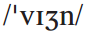
Words & Phrases
vision n. [U]
1. the ability to think about and plan for the future, using intelligence and imagination, especially in politics and business（尤指政治和商业方面的）远见，眼光，前瞻性
e.g. To tackle these environmental challenges will require
real vision and leadership.
解决这些环境问题需要真正的远见和领导能力。
2. the ability to see 视力
e.g.
Studies show that for adults there is no danger, but children can develop loss of vision if they have glasses inappropriate for their eyes. (CET4-2011-06)
研究表明，若眼镜选择不当，对于成人没什么危险，但可以导致儿童丧失视力。

Slide 37
Words & Phrases
dearth n. [sing] (fml) (~ of) a situation in which there is not enough of sth. 缺乏；不足
e.g.
But today’s crisis is not just a dearth of financial capital.
但目前的危机并非仅仅是资本的缺乏。
The 2012 host, London, faces numerous challenges, including tight budgets, security concerns, and a dearth of homegrown Olympic champions in many sports.
2012年奥运举办城市伦敦面临许多挑战，包括预算紧缺，安
全问题，以及在许多运动项目上缺乏本土奥运冠军。

Slide 38
Words & Phrases
revere vt. (fml) to have a lot of respect and admiration for sb. or sth. 尊崇；崇敬
e.g.
Students revere the old professors.
学生们十分尊敬那些老教授。
They have deep spiritual ties to the moon, and they revere the mighty moon-spirit as one of their greatest totems.
他们与月亮有很深的精神联系，他们尊敬强大的月之精灵，把它作为他们最重要的图腾之一。

Slide 39
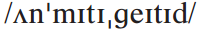
Words & Phrases
unmitigated a. used for emphasizing how bad or unpleasant sth. is（用于强调某事糟糕或令人不快的程度）全然的，十足的
e.g.
1. Don’t believe him, what he said was an unmitigated lie.
别信他，他说的是彻头彻尾的谎言。
2. The tour was an unmitigated disaster.
那次旅行是一次十足的灾难。

Slide 40
Words & Phrases
occasionally ad. sometimes, but not frequently or regularly 偶然；偶尔
e.g.
The following adverse reactions may occasionally occur: dryness of the mouth, thirst, drowsiness, fatigue, dizziness and abdominal discomfort.
偶尔可能出现下列副作用：口干、口渴、发困、乏力、头晕、
腹部不适。
I’ll occasionally go to a local jazz evening with friends.
我有时会跟朋友去参加当地的爵士乐之夜。
Word family: occasion n. occasional a.

Slide 41
Words & Phrases
mentor n. [C] an experienced person who helps sb. who has less experience, especially in their job 指导者；导师
e.g.
My mentor accepted my invitation to dinner with good grace.
我邀请导师吃晚餐，他愉快地接受了我的邀请。
He fed on the great ideas of his mentor.
他以他导师的伟大思想为支撑。

Slide 42
Words & Phrases
glimpse n. [C]
1. (~ of / into) an experience that gives you an idea of what sth. is like 窥见某物之一斑
e.g.
Her worried face gave me a glimpse of her true feelings.
她担心的表情使我感受到她的真实感情。
As university campuses become increasingly multi-ethnic, they offer a glimpse of the conflicts of the society that students will face tomorrow.
大学校园变得日益多种族化，学生通过校园可以对未来将要
面对的社会中的诸多冲突有一个初步的认识。

Slide 43
Words & Phrases
2. an occasion when you see sb. or sth. for a moment only 一瞥；一看
e.g.
The fans of the actress craned their necks to catch a glimpse of their idol.
那位女演员的粉丝们伸长了脖子想看一看他们的偶像。
A brief glimpse at a daily newspaper vividly shows how much people in the United States think about business. (CET4-2003-06)
快速扫视一份日报就能发现美国人多么看中商业。

Slide 44
Words & Phrases
advanced a.
1. at a high academic level 高级的；高等的
e.g.
The course is suitable for beginners and advanced students.
本课程适合初学者及程度较高者。
The lab has recently been updated to allow for more advanced courses.
实验室最近经过更新，可以上更高阶的课程了。

Slide 45
Words & Phrases
2. based on the most recent methods or ideas 先进的
e.g.
It’s the most advanced optical telescope in the world.
这是世界上最先进的光学望远镜。
His ideas are advanced, and only a few people could understand him.
他思想先进，只有少数人能理解他。
Word family: advance v. & n.

Slide 46
Words & Phrases
algebra n. [U] a type of mathematics that uses letters and other signs to represent numbers and values 代数学
e.g.
He was not good at algebra in middle school.
他中学时不擅长代数。
In algebra, the sign X usually denotes an unknown quantity.
在代数里，符号X常用来表示未知数。

Slide 47
Words & Phrases
malign vt. to say unpleasant things about sb., usually unfairly 诽谤；中伤；污蔑
e.g.
She had seen herself repeatedly maligned in the newspaper.
她认为自己在报纸上一再受到诽谤。
We maligned him dreadfully when you come to think of it.
细细想来，我们曾狠狠地中伤了他。

Slide 48
Words & Phrases
sum n. [C] (~ of) a total amount made by adding several numbers or amounts together 总数；总和
e.g.
1. The sum of 6 and 4 is 10.
6加4等于10。
2. The expenses came to an enormous sum.
开支总数巨大。

Slide 49
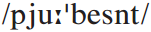
Words & Phrases
pubescent a. (of a child) at a stage in their life when their body is changing and they are becoming an adult 青春期的；发育期的
e.g.
She writes about her pubescent and rebellious behaviour.
她描写了她青春期的、叛逆的行为。
In an impoverished rural society, pubescent girls are bought and sold like cattle, and often treated little better.
在贫穷的农村地区，青春期的女孩被当做牲口一样贩卖，也
被当做牲口一样对待。

Slide 50
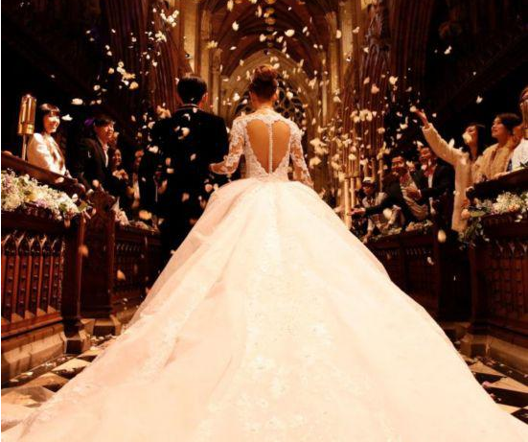
Words & Phrases
aisle n. [C] a passage between rows of seats, for example in a church, theatre, or plane（教堂、剧院或飞机上两排座位间的）过道，走廊
e.g.
1. A quick movement across the aisle caught his eye.
有个人影在走道里一闪而过，引起了他的注意。
2. He was in no hurry to walk down the aisle.
他并不急于结婚。

Slide 51
Words & Phrases
lean vi.
1. (~ forward / back / towards / across etc.) to move your body so it is closer to or further from sb. or sth. 探身；弯腰；屈身
e.g. He was leaning forward, talking to the people in front.
他倾斜身子，跟面前的人交谈。
2. (~ against) to stand or be set at an angle against sth. for support instead of being upright 倾斜；倚靠；斜靠
e.g. What else could they lean on except the big firms to
support the economy in times like these?
在这样的形势下，除了这些大企业，他们又能依靠谁来支持
经济呢？

Slide 52
Words & Phrases
rub v. to press and move your hands or an object over a surface（用手或物体）擦，摩擦
e.g.
1. The little boy nodded and then rubbed his eyes wearily.
小男孩点了点头，然后疲倦地揉了揉眼睛。
2. “I fell in a ditch”, he said, rubbing at a scrape on his hand.
“我掉进沟里了”，他一边说着，一边揉着手上的擦伤。

Slide 53
Words & Phrases
agony n. [C, U]
1. a strong and unpleasant feeling, especially great worry or sadness 痛苦；煎熬
e.g. Except Gods, who can be happy in all his life without
any agony? —(Ancient Greece) Aeschylus
除了神以外，谁能够永远悠悠一生，没有痛苦？——(古希
腊)埃斯库罗斯
2. great pain 剧痛
e.g. He fell awkwardly and went down in agony clutching
his right knee.
他笨拙地摔倒了， 痛苦地抱住右膝倒在地上。

Slide 54
Words & Phrases
tactile a. concerning the sense of touch 触觉的
e.g.
Touch each object you want to touch as if tomorrow your tactile sense would fail.
抚摸每一件你想要抚摸的物品吧，犹如明天你的触觉将衰退。
Birds are known to use visual, auditory, and possibly vibrations or tactile cues to find prey, but vision is predominant.
我们知道鸟类采用视觉，听觉，可能还有振感或触觉来寻找食
物，但是视觉是起支配作用的。

Slide 55
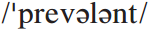
Words & Phrases
prevalent a. very common in a particular place or among a particular group 盛行的；普遍的
e.g.
The custom of worshipping ancestors is prevalent among these people.
崇拜祖先的风俗在这些人中是普遍的。
Cheating is so prevalent and so widely accepted that it becomes a way of academic life.
作弊是那么盛行和普遍，已成为学术生活中的一个方面。

Slide 56
Words & Phrases
presence n. [U]
1. (in sb.’s ~/ in the ~ of sb.) in the same place as sb. 有某人在场；有某人出席
e.g.
A graduated license requires that a teenager first prove himself capable of driving in the presence of an adult, followed by a period of driving with night of passenger restrictions, before graduating to full driving privileges. (CET4-2003-09)
Even though I was a professor by that time, I felt like a young apprentice in the presence of the brilliant master.
青少年获得驾驶毕业证之前，首先需要证明能够在成人陪伴下独自驾驶，然后经历一段在夜间严禁搭载乘客的驾驶经历。
尽管那时候我已经身为教授，可在这位卓越的大师面前，我觉得自己就像是年轻见习生。

Slide 57
Words & Phrases
2. the existence of sb. or sth. in a particular place 存在；在场；出席
e.g.
1. She was so quiet that her presence was hardly noticed.
她那么安静，几乎没有人注意到她在这里。
2. She darkened the festivities by her presence.
她的出席给这次庆祝活动笼罩上一层阴影。
Word family: present a.

Slide 58
Words & Phrases
humiliate vt. to make sb. feel very embarrassed and ashamed 使蒙羞；使丢脸
e.g.
She had been beaten and humiliated by her husband.
她遭到丈夫的殴打和羞辱。
Parents are humiliated if their children behave badly when guests are present.
子女在客人面前举止失当，父母也失体面。
Word family: humiliation n.

Slide 59
Words & Phrases
affirm vt. (fml) to state that sth. is true or you agree with it, especially in public（尤指公开地）断言，声明，肯定，证实
e.g.
This report is positively denied in official circles, who affirm that nothing of the kind occurred, but that the story is made out of whole cloth.
这篇报导为官方人士所明确否认，他们断言根本没有这回事，
其内容纯属捏造。
Everything I had accomplished seemed to affirm that opinion.
我所取得的一切似乎都证明那个观点是对的。

Slide 60
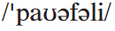
Words & Phrases
powerfully ad.
1. in a way that the feeling or effect is very strong or great （效果）巨大地；（感情）强烈地
e.g. Music can have a powerfully subliminal effect.
音乐能产生强烈的潜意识效果。
2. in a way that is able to influence or control what people do or think 有影响力地；能控制他人地
e.g. Mobile phones of the latest fashion appeal powerfully
to the young.
最新款式的手机很吸引年轻人。
Word family: power n. powerful a.

Slide 61
Words & Phrases
think for yourself: to consider facts and make decisions, instead of depending on sb. else’s judgment 自己做决定；独立思考
e.g.
Don’t let him take away your freedom to think for yourself.
别让他夺去你独立思考的自由。
You are not meant to think for yourself; you are here to carry out my orders.
你们的职责不是自作主张；你们是来执行我的命令的。

Slide 62
Words & Phrases
on purpose: deliberately （为了特定目的）特意地，故意地
e.g.
1. Was it an accident or did David do it on purpose?
是意外还是戴维故意所为？
2. I don’t think he stepped on your toes on purpose.
我想他不是有意得罪你的。
3. She sometimes does things on purpose just to annoy me.
她有时存心做些事来使我生气。

Slide 63
Words & Phrases
not think much of: to not like sb. or sth. very much 不大喜欢
e.g.
I do not think much of her as a musician.
她作为一名音乐家，我认为不怎么样。
If this generation does not tackle climate change, its descendants will not think much of it.
如果我们这代人对气候变化置之不理，那么我们的后代也不
会对此加以重视。

Slide 64
Words & Phrases
find out: to discover a fact or piece of information 发现，查明，弄清（事实或信息）
e.g.
We need to find out more about these night courses.
我们需要进一步了解这些夜校的课程。
Science, to my mind, is applied honesty, the one reliable means we have to find out truth.
在我心目中，科学是应用诚实学，是我们掌握的发现真理的
惟一可靠手段。
A number of tests have been carried out to find out if these drugs have any effect.
人们已经做了一些实验来弄清楚这些药品是否有疗效。

Slide 65
Words & Phrases
for that matter: (mainly spoken) used for emphasizing that sth. else is also true 而且（用于强调其他事情也是真的）
e.g.
In fact, the air quality of a house has a great deal to do with children’s health, and adults’ health for that matter.
事实上，室内空气质量与儿童的健康密切相关，当然与成人
的健康也有关系。
He never touched beer, or any kind of alcohol for that matter.
他从来不沾啤酒，对任何别的酒也是如此。

Slide 66
Words & Phrases
at (great / some) length
1. for a long time and with a lot of detail 长久地；详尽地；啰嗦地
e.g.
We’ve already discussed the subject at great length in previous meetings.
在以前的会议中，我们已经用了很长的时间来讨论这一话题。
Well, we have discussed the matter at length.
这件事我们已经仔细讨论过了。

Slide 67
Words & Phrases
2. (literary) after a long time 最后 ；终于
e.g.
At length, the day came when they were to leave.
终于到了他们要走的那一天。
At length the young lady raised her head and looked steadily at his intelligent face.
那个年轻妇女终于抬起头, 目不转睛地盯着他心领神会的脸。

Slide 68
Words & Phrases
start up: to switch on a machine or engine, especially a motor vehicle 发动
e.g.
Be sure your lever is in neutral before you start up your car.
在发动汽车前，你一定要确保汽车的变速杆处于空挡位。
Start up the game, create a character, click a button and the game world shows up.
你运行游戏，然后创建一个角色，再点击一个按钮，然后马
上就可以开始玩了。

Slide 69
Words & Phrases
be about to do: to be going to do sth. very soon 即将做某事
e.g.
1. Sit down everyone. The film’s about to start.
大家坐下，电影马上开始。
2. The President is about to wind up his visit to Somalia.
总统即将结束对索马里的访问。
3. She was standing by a pool, about to dive in.
她站在水池旁边，正要往里跳。

Slide 70
Words & Phrases
at least
1. even if nothing else happens or is true 无论如何；不管怎样；至少
e.g.
I would like to prove to them that I can do something for this area — at least, for the women.
我想证明给他们看，我可以为这个地区做些什么——至少为
女性做些什么。
She’s completely homeless at least I have my parents to fall back on.
她是真正无家可归——至少我有父母可以依靠。

Slide 71
Words & Phrases
2. not less than a particular amount or number（数量或数目上）至少，起码
e.g.
The mark-up on food in a restaurant is usually at least 100%.
餐馆食物的成本加价率通常至少是100%。
We should brush our teeth at least twice a day.
我们每天应该至少刷两次牙。

Slide 72
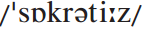
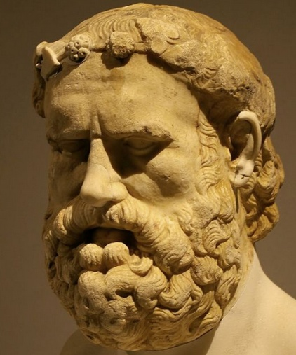
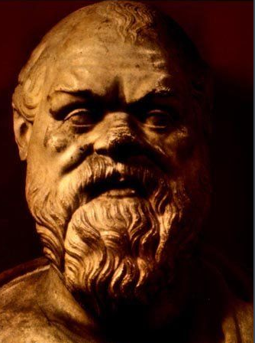
Words & Phrases
Socrates n. 苏格拉底（470–399 BC，古希腊哲学家）
Socrates was a Greek philosopher. He was unfairly charged with corruption of the young people of Athens and put to death. He didn’t write any books, but his ideas were recorded by Plato in The Dialogues of Plato and have had a major influence on Western thought. The Socratic method of teaching was largely through a dialogue in which the teacher (Socrates) asked students a series of questions which made them think for themselves about how people should conduct their lives.

Slide 73


Language Points
… particularly in places that shape our lives — families, schools and most workplaces …
The idea behind this sentence is that our lives are significantly influenced by places or social institutions like the family, school or workplace.
翻译：
……尤其是那些影响我们一生的地方——家庭、学校以及大部分工作场所……

Slide 74
Language Points
… when a fellow guest asked me the subject of a book …
fellow: adj. used for talking about people who are similar to you or in the same situation as you
e.g.
fellow workers / fellow students / fellow countrymen
同事 / 同学 / 同胞
翻译：
……当一位客人问起我（酝酿中的）一本书的主题时……

Slide 75
Language Points
I later found out that he is the fourth-generation president of one of the largest oil companies.
What the writer wants to convey by mentioning the identity of the fellow guest is that if a person of such a high position doesn’t even think much of the idea of thinking for yourself, it can be seen how serious the problem is. Thinking for yourself as an important quality has been widely ignored by people.
翻译：
后来，我得知他是一家大公司的第四代掌门人，而那家 公司是世界上最大的石油公司之一。

Slide 76
Language Points
When was the last organizational vision statement you saw that included the words “… to develop ourselves into a model environment in which everyone at every level can think for themselves”?
The writer is questioning whether the mission statement of organizations or institutions includes words about staff at all levels thinking for themselves.
翻译：
“在我们周围逐渐创建出一个模型环境，使各个层次的人都有独立思考的空间。”你最后一次看到包含上述字眼儿的机构愿景陈述是在什么时候？

Slide 77
Language Points
And neither were theirs.
When we put “neither” or “nor” at the beginning of a sentence, we should use the inverted order, similar words are: hardly, never, little, scarcely, rarely, seldom …
e.g.
Never have I read such a shocking book.
我从没读过如此令人震撼的书。
Seldom did I go to the cinema without learning something new.
每次去看电影，我都能有所收获。
Hardly had the car stopped when the waiting crowd ran towards it.
汽车刚刚停下来，等待的人群就跑了过去。

Slide 78
Language Points
We may have learned to revere thinkers like Socrates, but we also learned that the state poisoned him for thinking for himself: not unmitigated encouragement.
not unmitigated encouragement: It means that the authorities’ treatment of Socrates and his death offer very little encouragement to us to think for ourselves. The word unmitigated is used to emphasize how bad or unpleasant something is, and with the negative not it has an ironic tone.
翻译：
我们可能早就知道应该尊敬像苏格拉底那样的思想家，可是我们也知道，因为独立思考，他所在的城邦毒死了他。这可绝不是给予他的毫无保留的鼓励。

Slide 79
Language Points
We may have learned to revere thinkers like Socrates, but we also learned that the state poisoned him for thinking for himself: not unmitigated encouragement.
Here “not unmitigated” is a double negation. Similar expressions are: not uncommon, not unreasonable, not unexpected …
Another kind double negation is “not without”.
e.g.
1. Such a big investment in the project is not without risk.
对这项工程巨大的投资不是没有风险。
2. They, not unexpectedly, did not respond.
他们没有答复, 这完全是意料之中的事。

Slide 80
Language Points
They give us glimpses.
Our teacher or mentor makes us realize the importance of thinking for ourselves.
翻译：
他们让我们（对独立思考的重要性）有了浅略的认识。

Slide 81
Language Points
I wondered what in the world they were writing.
Here in the world is used for emphasis.
Another phrase of similar purpose is on earth.
e.g. What on earth are you talking about?
你到底在说什么？
翻译：
我真不知道他们到底在写什么。

Slide 82
Language Points
After the agony among us had become tactile …
The students’ agony was so obvious that they could feel the agony physically (it was almost touchable — note that this is hyperbole; it was not literally tactile).
翻译：
在明显地感觉到我们的苦恼之后……

Slide 83
Language Points
There is no such thing as the sum of a number.
there is no such thing as … : there is no article before the word “thing”.
没有…这样的东西或事情
翻译：
根本就不存在一个数字的和。

Slide 84
Language Points
I was too scared around that teacher for the rest of my young life to think very well in her presence.
In asking the question “write the sum of a number”, the teacher set a trap for the students. As a result of the teacher’s approach, the writer felt afraid in her presence, which prevented the writer from thinking well for some time.
翻译：
在后来的青葱岁月里，我一见到这位老师就害怕。在她面前，我根本就无法好好地思考。

Slide 85
Language Points
… had she not fanned our fear of her, we would all have learned even more powerfully what it meant to do our own thinking.
fan: Here it means to make a feeling or belief stronger. Fanning the students’ fear is a metaphor, based on fanning the flames of a fire. In this context, although the students learned something about thinking for themselves, it was limited because the teacher’s method evoked fear among the students.
翻译：
……要是她没有激起我们对她的畏惧，我们大家就能更深切地体会到独立思考的意义。

Slide 86
Language Points
… had she not fanned our fear of her, we would all have learned even more powerfully what it meant to do our own thinking.
Pay attention to the inverted order of the sentence. If we omit the word “if” in a subjunctive clause, we should use inverted order, putting “had” at the beginning of the sentence.
e.g.
如果没有你的帮助，我们永远也不可能克服这些困难。
If it had not been for your help / Had it not been for your help, we would never have been able to get over the difficulties.

Slide 87

Exercises
Reading and understanding
Dealing with unfamiliar words
Reading and interpreting
Developing critical thinking

Slide 88
Exercises
Reading and understanding
3 Choose the best answer to the questions.
1 Why does the writer believe thinking for oneself is not popular?
(a) Because it takes too much time.
(b) Because it is regarded as dangerous.
(c) Because it doesn’t lead to progress.
(d) Because only a few people are able to do it.

Slide 89
Exercises
2 How often, in the opinion of the writer, are people interested in your ideas?
(a) Always.
(b) Often.
(c) Hardly ever.
(d) Never.

Slide 90
Exercises
3 Who first made the writer realize thinking for oneself is important?
(a) The manager of an oil company.
(b) The writer’s parents.
(c) The writer’s maths teacher.
(d) The writer’s friend, Sarah.

Slide 91
Exercises
4 How did the writer feel when she was asked to write “the sum of a number”?
(a) Pleased, because it was an easy question to answer.
(b) Bored, because she wasn’t interested in maths.
(c) Worried, because she was the only one who didn’t
know the answer.
(d) Confused, because she didn’t understand the question.

Slide 92
Exercises
5 What did she do in the end?
(a) She copied what someone else wrote.
(b) She suddenly realized the meaning of the question.
(c) She felt too frightened to write an answer.
(d) She asked the teacher to explain.

Slide 93
Exercises
6 What does the writer think of her maths teacher?
(a) She was the best teacher the writer ever had.
(b) She was the worst teacher the writer ever had.
(c) She taught the writer an important lesson.
(d) She valued the intelligence of her students.

Slide 94
Exercises
Dealing with unfamiliar words
4 Replace the underlined words with the correct form of the words below.
5 Answer the questions about the words and expressions below.
6 Complete the sentences with the correct form of the words and expressions in Activity 5.
7 Answer the questions about the words.

Slide 95
Exercises
4 Replace the underlined words with the correct form of the words below.
lean occasionally particularly
rub sum suspicion vision
1 I had a vague feeling that I’d got the calculation wrong.
suspicion
2 He’s a good manager of people, but he lacks the ability to plan for the future.
vision
3 The lecturer bent over the student’s shoulder to see what she was writing.
leaned

Slide 96
Exercises
4 The total amount was the addition of all the numbers together.
sum
5 I sometimes see colours as sounds, and words as music.
occasionally
6 He found the lecture difficult to follow not least because it was especially hard to hear.
particularly
7 The teacher moved her hands together backwards and forwards, as if to say, “I’m looking forward to this!
rubbed

Slide 97
Exercises
5 Answer the questions about the words and expressions below.
affirm agony at length
glimpse on purpose presence radical
1 If someone affirmed something, did they show (a) they respected and approved of it, or (b) disrespected or disapproved of it?
2 If you are in agony about something, do you feel (a) in pain and uncomfortable, or (b) happy and comfortable?
3 If someone speaks at length, do they speak (a) for a long time, or (b) for a short time?
5 Answer the questions about the words and expressions below.
affirm agony at length
glimpse on purpose presence radical
1 If someone affirmed something, did they show (a) they respected and approved of it, or (b) disrespected or disapproved of it?
2 If you are in agony about something, do you feel (a) in pain and uncomfortable, or (b) happy and comfortable?
3 If someone speaks at length, do they speak (a) for a long time, or (b) for a short time?

Slide 98
Exercises
affirm agony at length
glimpse on purpose presence radical
4 If you get a glimpse of something, do you see it (a) clearly and for a long time, or (b) not very clearly and for a short time?
5 If you do something on purpose, do you (a) mean to do it, or (b) do it by accident?
6 If you do something in the presence of someone, are they (a) with you, or (b) somewhere else?
7 Is a radical idea (a) traditional and widely accepted, or (b) new and different?
affirm agony at length
glimpse on purpose presence radical
4 If you get a glimpse of something, do you see it (a) clearly and for a long time, or (b) not very clearly and for a short time?
5 If you do something on purpose, do you (a) mean to do it, or (b) do it by accident?
6 If you do something in the presence of someone, are they (a) with you, or (b) somewhere else?
7 Is a radical idea (a) traditional and widely accepted, or (b) new and different?

Slide 99
Exercises
6 Complete the sentences with the correct form of the words and expressions in Activity 5.
affirm agony at length
glimpse on purpose presence radical
1 Many people greet ___________ ideas nervously because they are afraid of change.
2 Looking at the drawings of Leonardo da Vinci, you feel as if you are in the ____________ of a genius.
3 She talked ___________ about her work but hardly mentioned anything about her personal life.
radical
presence
at length

Slide 100
Exercises
affirm agony at length
glimpse on purpose presence radical
4 I twisted my ankle three days ago, but I’m still in _______.
5 Tom’s excellent exam results ________________ the teacher’s faith in his ability.
6 The police think the fire was started ___________.
7 Everyone was hoping for a(n) ____________ of the famous professor as he arrived and went inside.
agony
affirm / affirmed
on purpose
glimpse

Slide 101
Exercises
7 Answer the questions about the words.
1 If you thwart something, do you (a) stop it, or (b) encourage it?
2 If there is a dearth of something, is there (a) a lot of it, or (b) not enough?
3 Does unmitigated encouragement suggest (a) completely positive support, or (b) slightly negative support?
7 Answer the questions about the words.
1 If you thwart something, do you (a) stop it, or (b) encourage it?
2 If there is a dearth of something, is there (a) a lot of it, or (b) not enough?
3 Does unmitigated encouragement suggest (a) completely positive support, or (b) slightly negative support?

Slide 102
Exercises
4 If a teacher is maligned by their pupils, do you think they say (a) nice things, or (b) bad things about the teacher?
5 If you humiliate someone, do you make them feel (a) good, or (b) upset and embarrassed?
6 If something is prevalent, does it occur (a) often, or (b) not very often?
4 If a teacher is maligned by their pupils, do you think they say (a) nice things, or (b) bad things about the teacher?
5 If you humiliate someone, do you make them feel (a) good, or (b) upset and embarrassed?
6 If something is prevalent, does it occur (a) often, or (b) not very often?

Slide 103
Exercises
Reading and interpreting
8 Work in pairs. Look at the sentences from the passage and answer the questions.
1 Thinking for yourself is not a popular activity, though it should be.
Whose opinion does “though it should be” refer to?
It refers to the writer’s opinion. By telling the story the writer hopes to persuade readers to share her opinion.

Slide 104
Exercises
2 I was reminded of this sad fact at a party when a fellow guest asked me the subject of a book I was planning to write.
What is “sad”? What does this choice of word tell us about the writer’s opinion?
The word sad refers back to the fact that “thinking for yourself” is seen as dangerous, and institutionally it is not encouraged. The writer disapproves of this attitude towards “thinking for yourself”, so she uses the word sad to show her opinion and her approval of “thinking for yourself”. Using an adjective in this way is very effective in revealing the writer’s opinions and preferences in writing and speaking.

Slide 105
Exercises
3 For that matter, when was the last time somebody asked you, “What do you really think, really?” and then waited for you to answer at length?
What answer does the writer expect from this question?
The writer may expect an answer of “rarely”, because the writer has been indicating that “thinking for yourself” is not really encouraged; thus in asking this question, the writer doesn’t expect a positive answer.

Slide 106
Exercises
4 (We may have learned to revere thinkers like Socrates, but we also learned that the state poisoned him for thinking for himself: not unmitigated encouragement.)
Is this sentence a specific example of the main argument — thinking for yourself is not a popular activity — or does it contradict it?
Socrates is known as a great Greek thinker who taught people to think by asking questions, rather than by telling them answers, so people had to find the answers for themselves. However, Socrates was poisoned to death just because of his way of teaching. So this is a specific example of the main argument — thinking for yourself is not a popular activity.

Slide 107
Exercises
5 I remember my hand gathering sweat around the pencil.
How do you think the writer was feeling?
The writer was scared and nervous.

Slide 108
Exercises
Developing critical thinking
9 Work in pairs and discuss the questions.
1 Would you agree that not many people know how to think for themselves? Why / Why not?
2 In what way can “thinking for yourself” be dangerous?
3 If you were a teacher, what would you do to help students cultivate their critical thinking skills?

Slide 109
Exercises
1 Would you agree that not many people know how to think for themselves? Why / Why not?
This depends on the experience of individuals. In some cultures people are not encouraged to think for themselves. They are expected to follow leaders or famous people. This has both advantages and disadvantages. The advantages are that people may be guided to do things in a way that has been demonstrated to work. The disadvantages are that people may not know what to do when an unexpected problem occurs. In fact all people have to think for themselves one way or another during their lifetime. There needs to be some kind of balance between thinking for oneself and collaborating with others.

Slide 110
Exercises
2 In what way can “thinking for yourself” be dangerous?
Examples can include:
A self-interested leader may feel it is difficult to control those who think for themselves.
There could be too many opinions among independent thinkers, which could cause confusion or uncertainty.
Too much time might be spent on coming to an agreement with others rather than getting down to practical matters.

Slide 111
Exercises
3 If you were a teacher, what would you do to help students cultivate their critical thinking skills?
If I were a teacher, I would encourage my students to question what I say and ask for my evidence or sources. I would expect students to use reasoning and also to back up their assertions with evidence. In addition, I would encourage students to read widely and keep an open mind.

Slide 112


Extension Activities
Thinking Styles
In the past, it was common to use IQ (Intelligence Quotient) tests, which were meant to measure your intelligence. They mostly tested your linguistic and mathematical skills. IQ tests still exist, but today psychologists believe that people think in different ways, and there may be as many as seven different “thinking styles”. Here are some of the statements they ask people to choose to describe themselves.

Slide 113
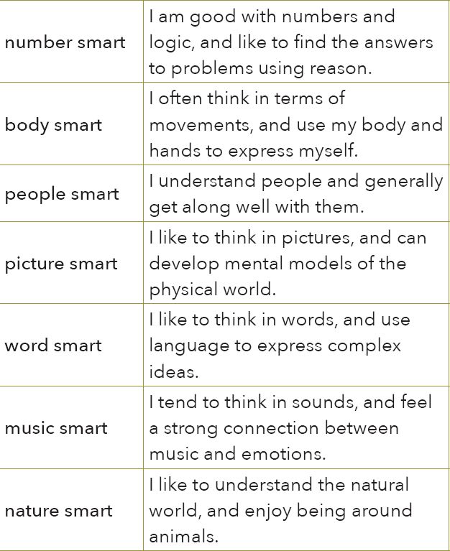
Extension Activities

Slide 114
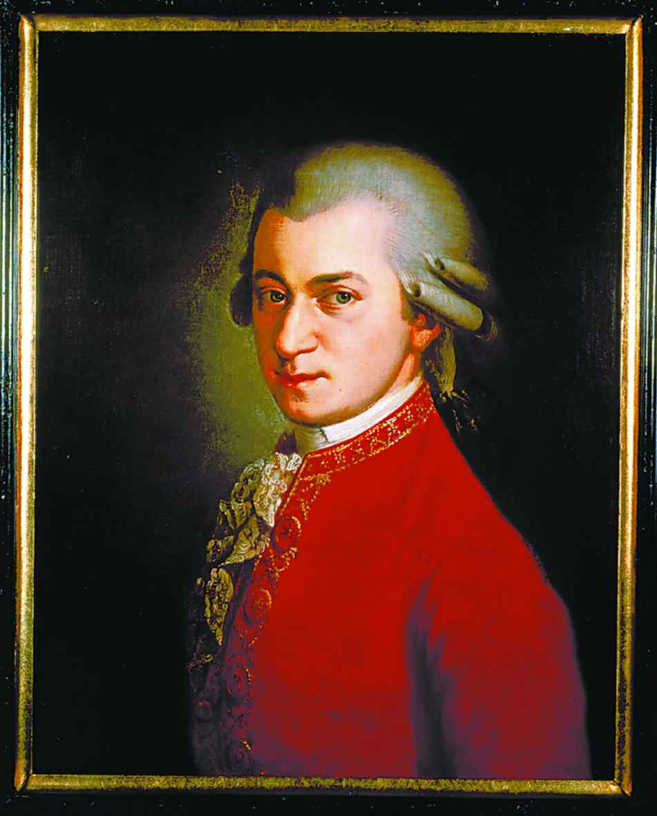
Extension Activities
1 Look at the chart and talk about some famous people you know, and decide which their main thinking styles are.
e.g.
Wolfgang Amadeus Mozart (1756–1791) is an influential composer and musician from Austria, who composed over 600 pieces of music in his short lifetime.

Slide 115
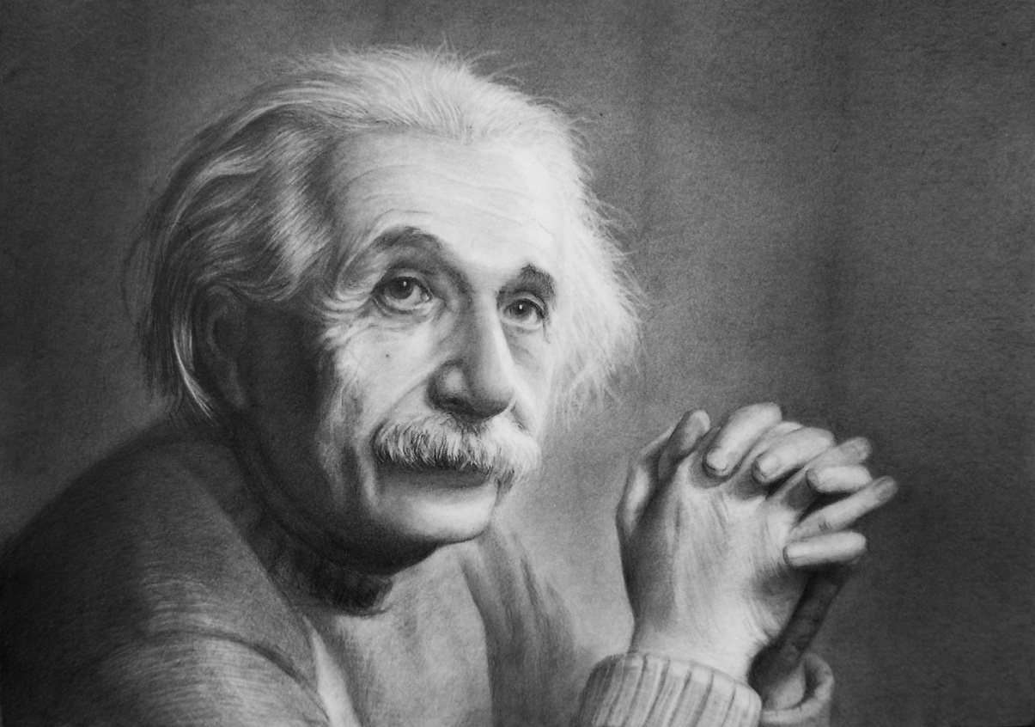
Extension Activities
Albert Einstein (1879–1955) is a German-born theoretical physicist who is smart in number, body, word and picture. He imagined the movements of things in space, and won the 1921 Nobel Prize in Physics.

Slide 116
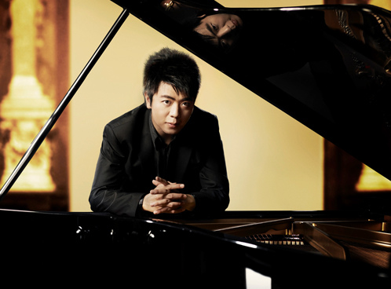
Extension Activities
Lang Lang, an internationally-known pianist from China, is music smart and perhaps people smart.

Slide 117
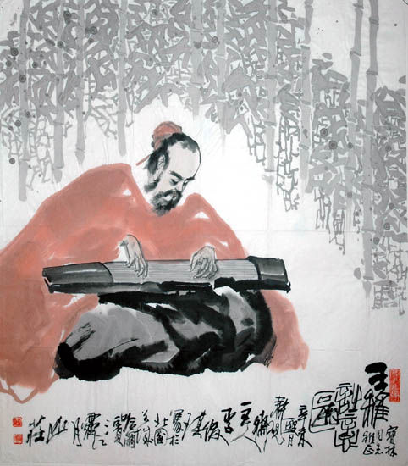
Extension Activities
Wang Wei (701–761), Chinese poet, painter and musician, must have been word, picture and music smart, and also nature smart with his visions of nature.

Slide 118
Extension Activities
Look at the chart again and choose the thinking style which is most true for you.

Slide 119

Thank you

